Slide 1
Recommendation System for places to Open a Food Court Chain in New York City
By S M Azizul Hakim

Slide 2
Background
The City of New York is the most populous city in the United States.
New York City has been described as the cultural, financial, and media capital of the world.
New York City is home to more than 3.2 million residents born outside the United States, the largest foreign-born population of any city in the world.

Slide 3
Business Problem
New York is the most diverse city in the United States.
The city manages to bring dishes from all over the world and make them it's own.
Over the past few decades, food courts have become an important way of experiencing the cities diverse food culture at a reasonable price.
This project aims to help any business person interested in opening a food court chain in New York City.
Our goal is to recommend the best places to open a food court in different neighborhoods.

Slide 4
Data preparation
New York City consists of 5 boroughs and 306 neighborhoods.
There is a opensource dataset with each neighborhood as well as the latitude and the longitude of each neighborhood.
We combined this data with the foursquare venue data to create the final dataset.

Slide 5
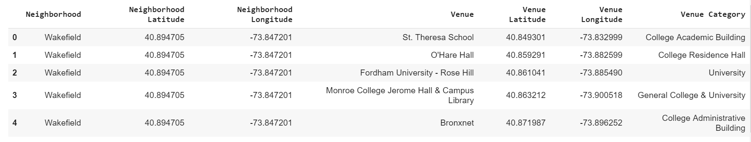
Data preparation(contd.)
Here is the final dataframe

Slide 6
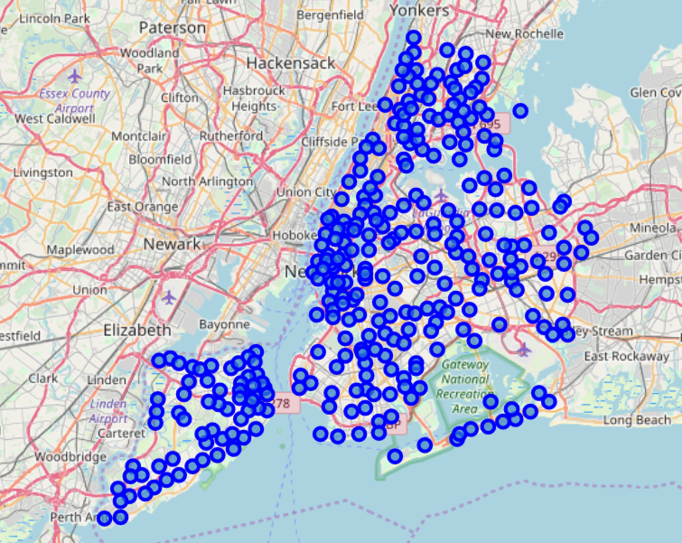
Data Preparation(contd.)
All the neighborhoods in map:

Slide 7
Exploratory Data Analysis
We have applied soe analysis on the data:
The dataframe is grouped by ‘neighborhood’ attribute. This shows how many desired venues located in each neighborhoods.
Calculated the number of unique categories in the dataframe.
We grouped rows by neighborhood and by taking the mean of the frequency of occurrence of each category.
Then we sorted the venues in descending order. Then we created a new dataframe displaying the top 10 venues for each neighborhood.

Slide 8
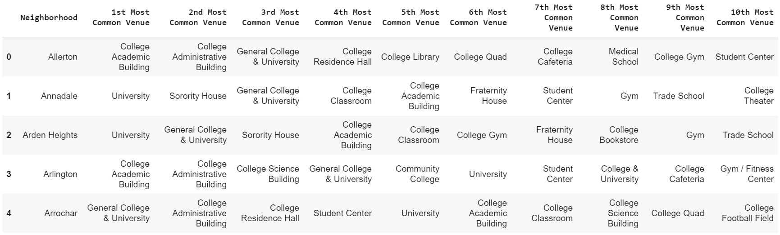
Exploratory Data Analysis(contd.)
A new dataframe displaying the top 10 venues for each neighborhood:

Slide 9
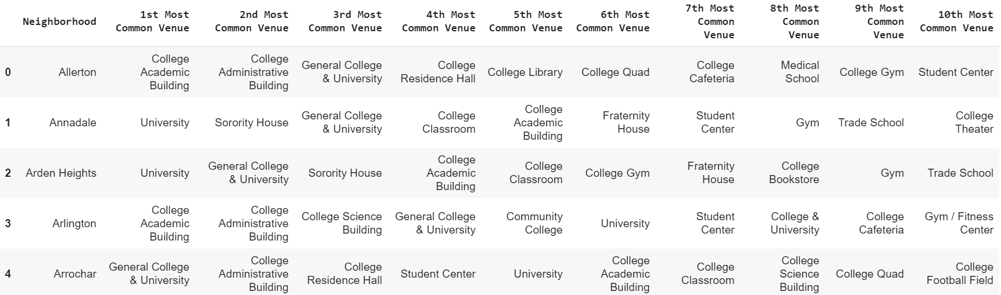
Clustering
We used K-means clustering and the number of clusters is set to 10:

Slide 10
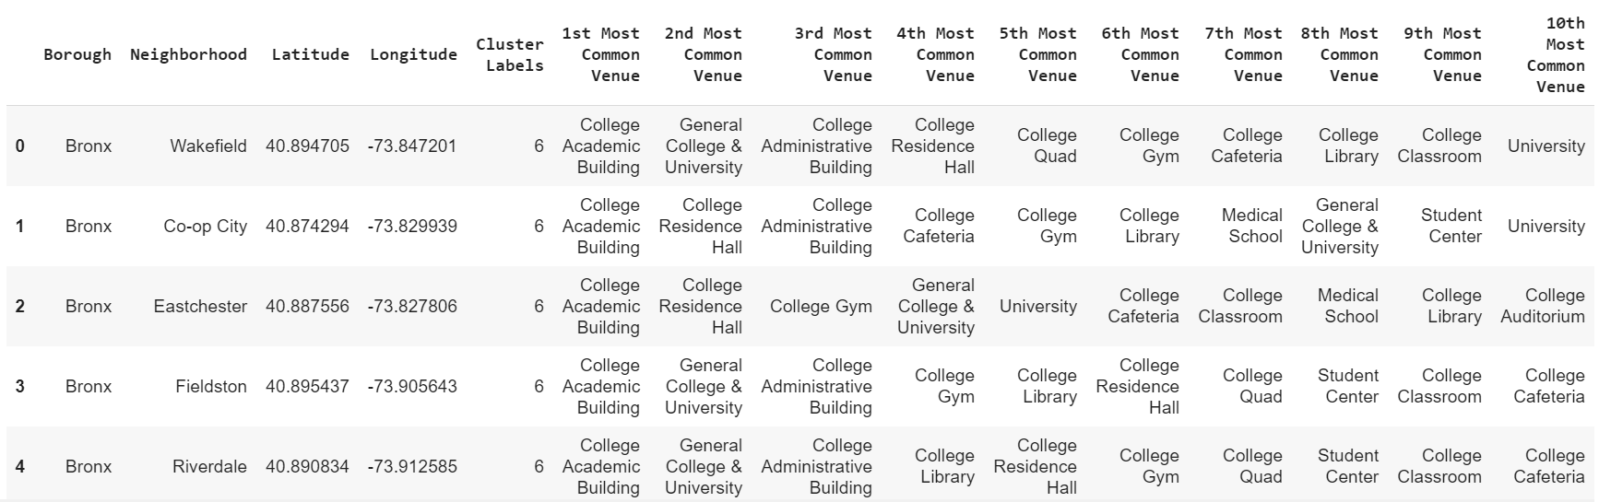
Clustering(contd.)
Clustered venues with the neighborhood they are located in:

Slide 11
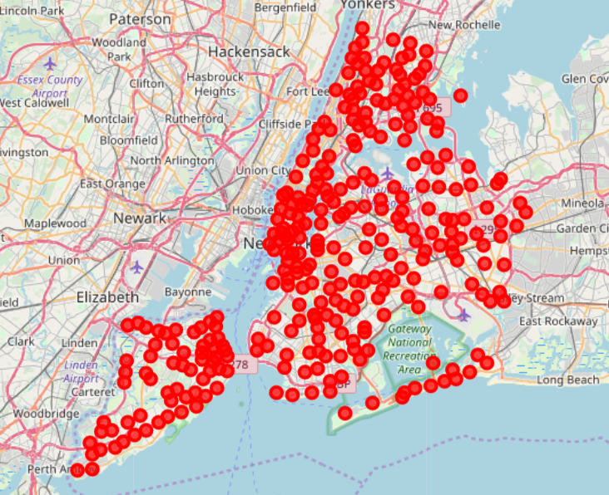
Results
We finally visualize the resulting clusters by adding them to a map of New York City using folium:

Slide 12
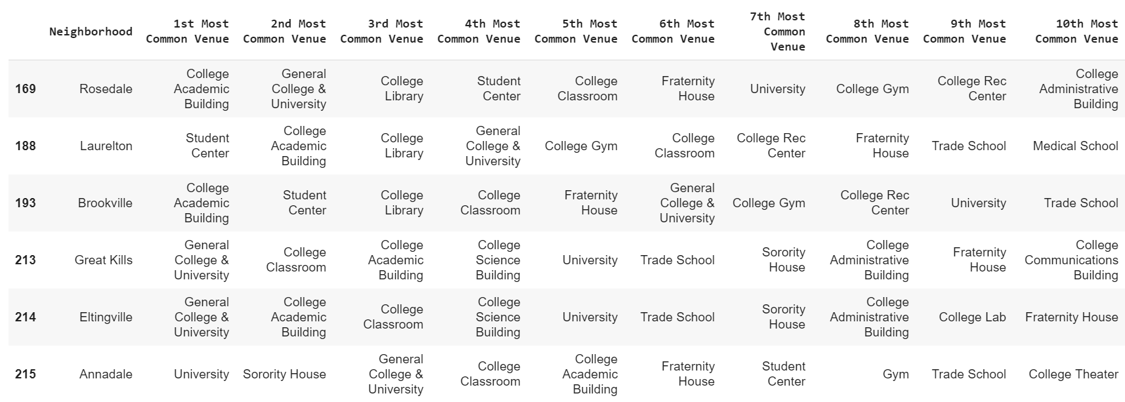
Results(contd.)
Here are some of the results of clustering
Cluster-1:

Slide 13
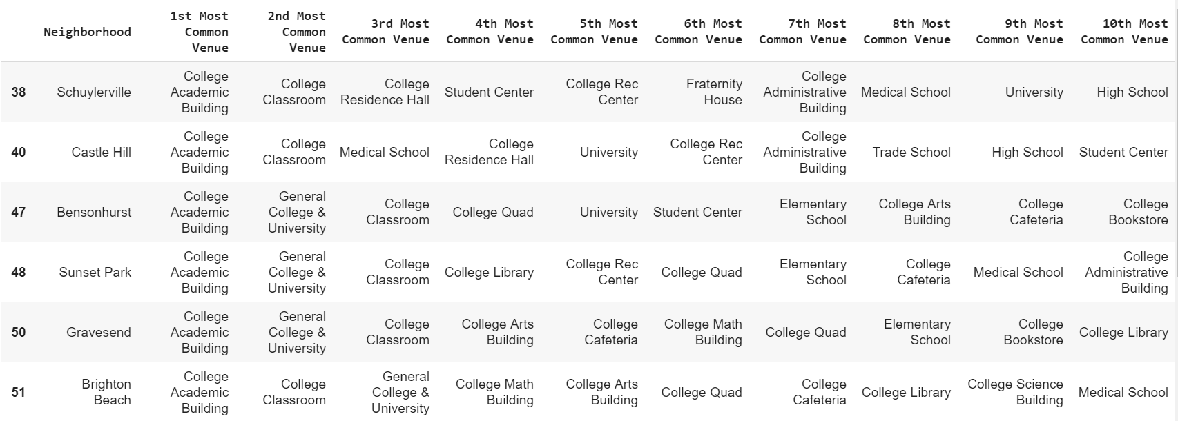
Results(contd.)
Cluster-5:

Slide 14
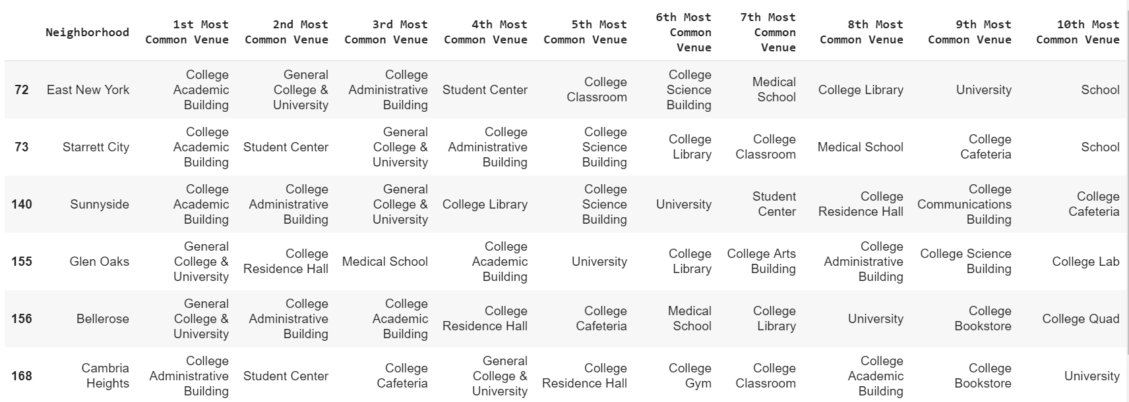
Results(contd.)
Cluster-10:

Slide 15
Conclusion
We can use the approximate number of students in a given venue to make better decision.
As food courts are mobile shops, we can move them from time to time to better exploit the recommendation.
These will require additional timeframe attribute to figure out places are most occupied by students between which time. This will increase our recommendation result more viable and robust.

Slide 16
Thank You

